Slide 1
General Ledger Master Data

Slide 2
Overview
The Master record contains data that controls how business transactions are recorded and processed by the system. (Chart of Accounts)
General ledger Master data
Purpose of master data creation to post the transactions using the master data
Profit Center and Segments

Slide 3
Business transactions are posted and managed in the general ledger via accounts. Each master record contains settings that control the flow of financial transactions
The G/L accounts record the business transactions in line item and totals form
In the standard system, all business transactions, which are posted to G/L accounts, are updated in the general ledger
Use

Slide 4

Chart of Accounts
The three steps to create and use a chart of accounts :
Define the chart of accounts
Define the properties of the chart of accounts
Assign the chart of accounts to company codes
The chart of accounts is a variant which contains the structure and the basic information about general ledger accounts
You define the chart of accounts with a 4 character identifier
You define the components of the chart of account, e.g. language, length of the G/L account number, group chart of accounts, status
The chart of accounts has to be assigned to every company code which would like to create accounts based on the defined structure

Slide 5

Define Chart of Accounts - Transaction Code – OB13
The definition of a chart of accounts contains:
Chart of accounts key
Description
General Information
Maintenance language
Length of the G/L account number
Controlling Integration
Manual or automatic creation of cost elements
Consolidation
Group chart of accounts
Status
“Blocked” indicator
Notes:
The maintenance language is the language in which account descriptions are maintained.
The length of the G/L account number can be from 1 to 10 digits.
Using the type of integration between G/L accounts and cost elements, you can control how the cost element master data is maintained when maintaining the master records of G/L accounts. You can manually maintain the cost elements, but it is also possible to have the cost elements automatically be created when creating G/L accounts. However, this is only possible if a default value has been entered for the cost element type, since the system assume that no cost element needs to be created if no default value exists.
A group account number can be entered into a G/L-account. This group account number is used for reporting across company codes which use different charts of accounts. If a group chart of accounts is entered into the chart of accounts, the system makes this field a required entry in the G/L master account and verifies that the group account number entered exists in the group chart of accounts.
A chart of accounts which is not yet completed can be blocked so that no company code can use it until ready.
You can create a directory of G/L accounts in your chart of accounts for information or
documentation purposes using the program RFSKPL00. The G/L chart of accounts is used to
display G/L account master records and for printing G/L account lists

Slide 6
Chart of Accounts…Contd
You can define an unlimited number of charts of accounts. Many country-specific charts of accounts are included in the standard system.
Chart of Accounts are of three types:
Operating Chart of Accounts
Country Specific Chart of Accounts
Group Chart of Accounts

Slide 7
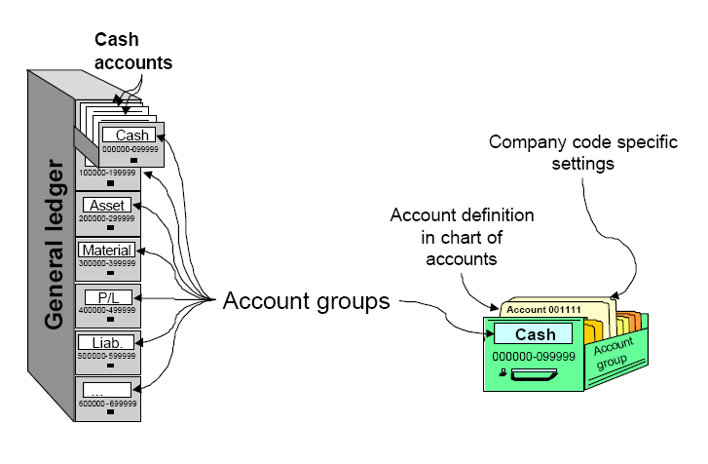
General Ledger Account Groups
In order to organize and manage a large number of G/L accounts better, they are arranged in account groups
The accounts of an account group normally have similar business functions. You could, for example, have an account group for cash accounts, one for expense accounts, one for revenue accounts, and one for other balance sheet accounts, etc.

Slide 8
GL Master Data
Client
in Chart of Accounts
COA 0010
COA “XXX”
c
e
n
t
r
a
l
l
y
in Company Code
Company Code
Company Code
Company Code
0010
0020
XXXX
Notes:
The GL account master record is divided into two segments: A chart of accounts segment and a company code segment.
The chart of accounts area contains the data that is valid for all company codes, such as the account number.
The company code specific area contains data that may vary from one company code to another, such as the currency in which the account may be posted.
The result is that individual company codes can control their business processing requirements, yet the common chart of accounts provides reporting capabilities across company codes.
There are available three different transactions to create a new GL account:
FS00: centrally
FSP0: in chart of accounts (only)
FSS0: in company code

Slide 9
G/L Master Data
Account Groups – Transaction Code OBD4
Maintenance
Creation at 2 Levels
Chart of Accounts Data
Company Code Data
Change
Block
Delete
Cost Elements
Creation

Slide 10
GL Account Groups
A Grp COA
Number Interval
Account Groups
Notes:
Different types of accounts can be bundled into different “account groups”. Usually one account group bundles accounts with the same tasks within the general ledger
By assigning a number range to an account group, you can ensure that accounts of the same type are within the same number range. Number intervals for G/L account master records can overlap.

Slide 11
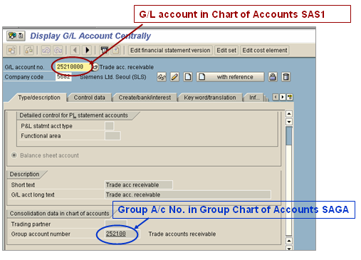
FI-SL: Assignment of GL accounts to Group Accounts -Transaction Code FS00

Slide 12
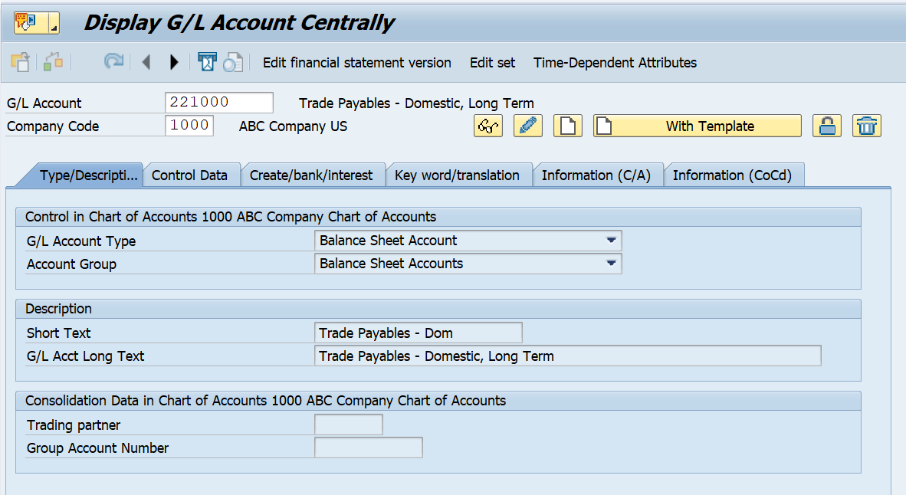
FI-SL: Assignment of GL accounts to Group Accounts -Transaction Code FS00

Slide 13
GL Account Master Record
General Ledger
Balance P&L
T T T T T
T T T T T
T T T T T
Chart of Accounts Segment
Acct number: 119430
Description:
Inventory – Finished goods
Account group:
Material Mgmt
Bal. sheet acct:
(Balance c/fwd)
Inc. statem. acct:
Bank account number
Aut. Posting control
Other reference data
Company Code Segment
Currency
Tax-related
Item management
Posting control...
Notes:
The GL account master record is divided into two segments: A chart of accounts segment and a company code segment.
The chart of accounts area contains the data that is valid for all company codes, such as the account number.
The company code specific area contains data that may vary from one company code to another, such as the currency in which the account may be posted.
The result is that individual company codes can control their business processing requirements, yet the common chart of accounts provides reporting capabilities across company codes.
There are available three different transactions to create a new GL account:
FS00: centrally
FSP0: in chart of accounts (only)
FSS0: in company code

Slide 14
More Information On General Ledger - Master Data
Line item The part of a document containing information on a single item. It always includes an amount, an account number, the assignment to debits or credits and further specifications which depend on the business transactions to be posted.
Line item display Display of line items from one or more accounts. The prerequisite for this is that accounts are managed with line item display. This is preset for customer and vendor accounts; for G/L accounts, it must be set in the master record of the account.
Open item management Specification that the items in an account must be cleared by other items in the account. The sum of items involved in the clearing procedure must be zero. The account balance is therefore always equal to the sum of the open items. This will be ticked for all clearing accounts or where the client wants clearing of line items.
Sort Key Indicates the layout rule for the Allocation field in the document line item.

Slide 15
More Information On General Ledger - Master Data
Key for Exchange Rate Differences in Foreign Currency Accts For the valuation of foreign currency balances, the system uses this key to find the accounts for gains and losses from the valuation. You specify which accounts valuation differences are to be posted to under the exchange rate difference key in the system.
Valuation Group A valuation group can include a number of different G/L accounts. The exchange rate type is determined from the foreign currency total when the valuation is carried out. The valuation groups can therefore be seen as an equivalent to the corporate group concept, except for customers and vendors. Valuation groups are freely definable, e.g. "Accounts at Citibank" "CITIB".
Posting without Tax Indicates that the account can still be posted to even if a tax code has not been entered. If you do enter a tax code when posting to this account, the system checks the entry against the tax category
Tax Category in Account Master Record Determines whether the following apply to the G/L account Is it tax-relevant? Is it a tax account? Is it a tax-relevant G/L account?
Notes:
Example-Exchange Rate Difference
You could have valuation differences posted to the same P&L account for all balance sheet accounts or to different accounts based on the currency.

Slide 16
Accounts in the General Ledger
Tips and Tricks
In order to create similar accounts quickly, click on the “Create with Reference” button. For example: if you are setting up multiple expense accounts, then reference a similar expense account. This will copy all of the attributes of the reference account. The user then has the option to change only the fields that are different from the reference account before saving.

Slide 17
Accounts in the General Ledger…Contd
Changing a G/L Account
To change data in the G/L account:
Enter the Account #
Click on the “pencil” icon on the initial screen.

Slide 18
Accounts in the General Ledger…Contd
Displaying a G/L Account
To display data in the G/L account:
Enter the Account #
Click on the “eye glasses” icon on the initial screen

Slide 19
GL Account Master Record
New field ‘G/L Account Type’ is added in G/L Master data in Chart of Account Segment. The general ledger account type determines how the general ledger account can be used in financial accounting (FI) and controlling (CO).
GL Master Data can be classified under the below options:
X – Balance Sheet Account
Balance Sheet Accounts
N- Non-operating Expenses or Income
Profit & Loss account used only in FI
P- Primary Costs or Revenue
Profit & Loss account used both in FI & CO
S- Secondary Costs
Profit & Loss account used only in CO
Notes:
The GL account master record is divided into two segments: A chart of accounts segment and a company code segment.
The chart of accounts area contains the data that is valid for all company codes, such as the account number.
The company code specific area contains data that may vary from one company code to another, such as the currency in which the account may be posted.
The result is that individual company codes can control their business processing requirements, yet the common chart of accounts provides reporting capabilities across company codes.
There are available three different transactions to create a new GL account:
FS00: centrally
FSP0: in chart of accounts (only)
FSS0: in company code

Slide 20
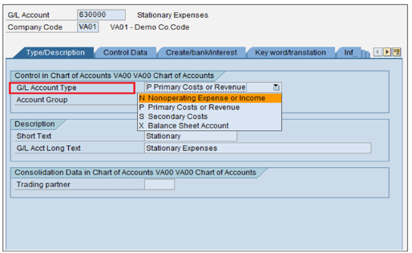

Slide 21
More Information On General Ledger Master Data
New Field ‘Cost Element Category’ under Control Data updates account settings for the Controlling Area
The following cost element categories are available when G/L account type P – Primary Cost or Revenue is selected
1 | Primary costs/cost-reducing revenues
3 | Accrual/deferral per surcharge
4 | Accrual/deferral per debit = actual
11 | Revenues
12 | Sales deduction
22 | External settlement

Slide 22
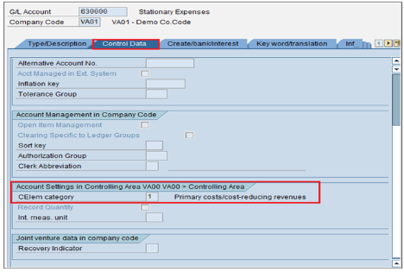

Slide 23
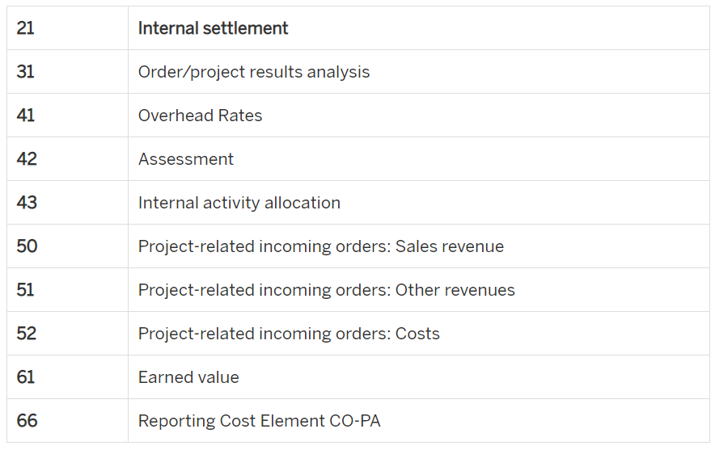
The following cost element categories are available when G/L account type S – Secondary Costs is selected.

Slide 24
More Information On General Ledger Master Data
Open Item Management
Specification that the items in an account must be cleared by other items in the account. The sum of items involved in the clearing procedure must be zero. The account balance is therefore always equal to the sum of the open items. This will be ticked for all clearing accounts or where the client wants clearing of line items
Sort Key
Indicates the layout rule for the Allocation field in the document line item

Slide 25
More Information On General Ledger Master Data
Key for Exchange Rate Differences in Foreign Currency Accts For the valuation of foreign currency balances, the system uses this key to find the accounts for gains and losses from the valuation. You specify which accounts valuation differences are to be posted to under the exchange rate difference key in the system.
Valuation Group A valuation group can include a number of different G/L accounts. The exchange rate type is determined from the foreign currency total when the valuation is carried out. The valuation groups can therefore be seen as an equivalent to the corporate group concept, except for customers and vendors. Valuation groups are freely definable, e.g. "Accounts at Citibank" "CITIB".
Posting without Tax Indicates that the account can still be posted to even if a tax code has not been entered. If you do enter a tax code when posting to this account, the system checks the entry against the tax category
Tax Category in Account Master Record Determines whether the following apply to the G/L account Is it tax-relevant? Is it a tax account? Is it a tax-relevant G/L account?
Notes:
Example-Exchange Rate Difference
You could have valuation differences posted to the same P&L account for all balance sheet accounts or to different accounts based on the currency.

Slide 26
Default Account Assignment in Cost Element Master Data
Default Account Assignment is NO longer available at Master data level in SAP S/4 HANA Finance
Default account assignment can be defined in Automatic account assignment (OKB9) or through substitution rules only
Default account assignments maintained in former cost element master data are migrated to OKB9 as a part of migration process

Slide 27
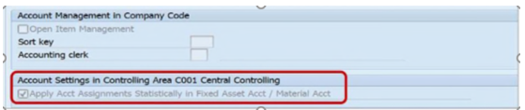
Statistical Cost Element for Balance Sheet accounts
Account which is used for planning capital expenditure on costing objects needs to define as statistical cost element (Cost element category – 90)
The following process to be followed for creating statistical cost elements in SAP S/4 HANA Finance
Account is created as G/L account type – Balance Sheet account
Account Group to be either Fixed Assets or Material Accounts
Account is a reconciliation account or material account
Accounts have been set up in Asset or Material management account assignment
Select ‘Apply Acct Assignments Statistically in Fixed Asset Acct/Material Acct’ checkbox in G/L account Master data as mentioned in below screenshot

Slide 28
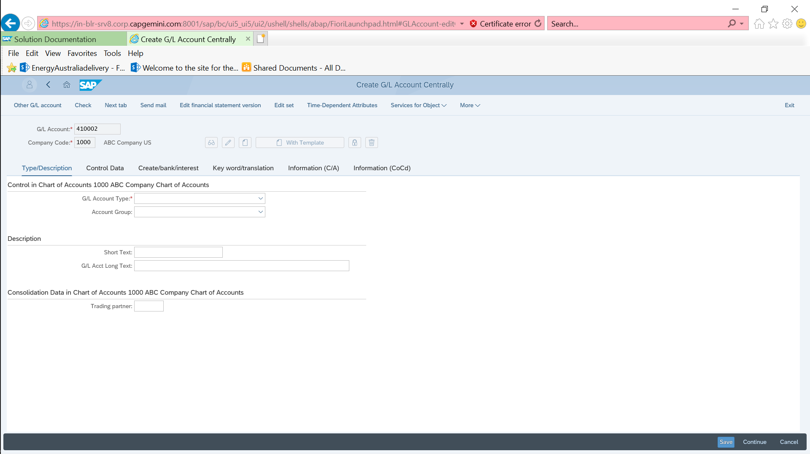
Create G/L Account
Step 1: Enter G/L Account Number
Step 2: Enter Company Code
Action(A1): Click on the Create icon
Step 3:Select G/L Account Type Balance Sheet Account/Nonoperating Expense or Income/P - Primary Costs or Revenue/Secondary
Step 4: Select Account group
Step 6: Enter Long text for this account
Step 5: Enter Short text for this Account

Slide 29
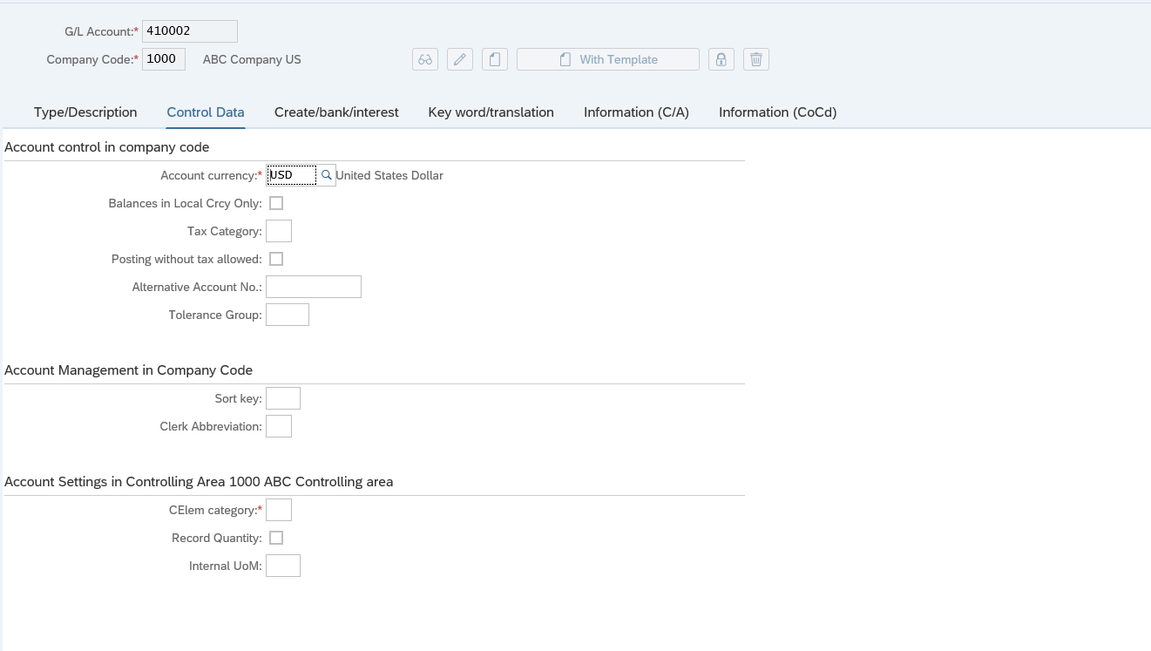
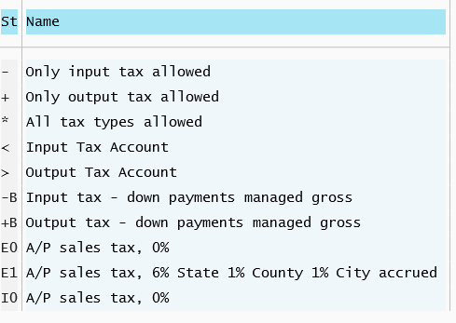
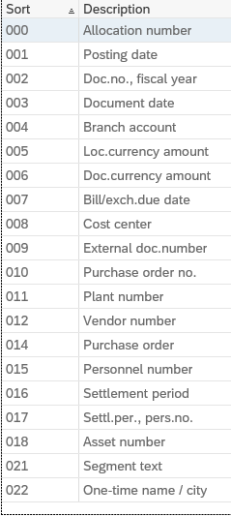
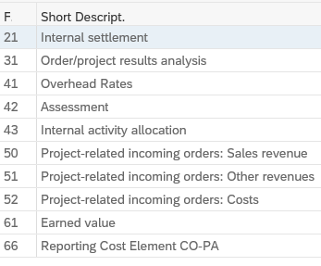
Create G/L Account
Step 7: Select Account Currency from the list
Step 8:Select Tax category from the list
Step 9:Check box, indicates that the account can still be posted to even if a tax code has not been entered
Step 10:Select Sort Key. Indicates the layout rule for the allocation field in the document line item
Step 11: Select Cost Element Category for the G/L account

Slide 30
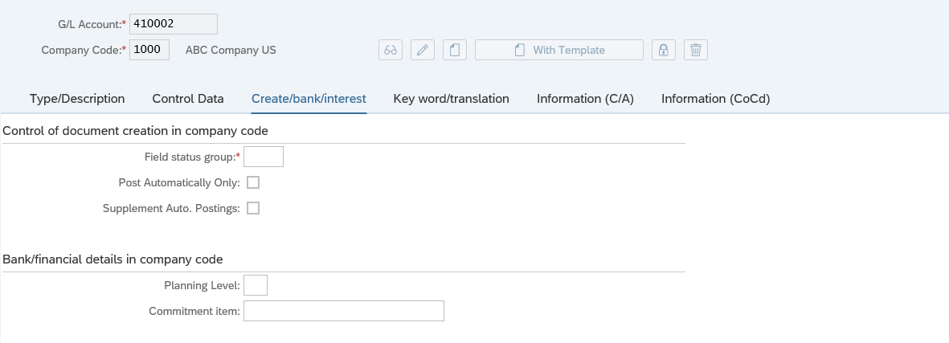
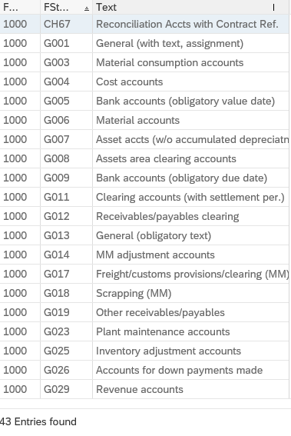
Create G/L Account
Step 12: Select Field Status group from the list. This determines screen layout
Step 13: Check box, indicates that the account can be posted automatically only
Step 14:Click on the Save to create GL account

Slide 31
PROFIT CENTER:
A profit center is an organizational unit in accounting that reflects a management-oriented structure of the organization for the purpose of internal control
You can analyze operating results for profit centers using either the cost-of-sales or the period accounting approach. By calculating the fixed capital as well, you can use your profit centers as investment centers
Profit center Accounting at the profit center level is based on costs and revenues. These are assigned statistically by multiple parallel updating to all logistical activities and other allocations of relevance for a profit center
The exchange of goods and services between profit centers can be valuated using the same valuation approach as financial accounting or another approach
The master data of a profit center includes the name of the profit center, the controlling area it is assigned to, and the profit center’s period of validity, as well as information about the person responsible for the profit center, the profit center’s assignment to a node of the standard hierarchy, and data required for communication (address, telephone number and so on)
Every profit center is assigned to the organizational unit controlling area. This assignment is necessary because Profit Center Accounting displays values in G/L accounts

Slide 32
PROFIT CENTER Cont..
Define Profit Center
PATH: SPRO - Controlling - Profit Center Accounting - Master Data - Profit Center - Define Profit Center Transaction Code: KE51
Click on “Execute”, the following window will display:
Double click on “EC-PCA: Create Profit Center” or select that and click on button

Slide 33
PROFIT CENTER Cont..
In Profit center field any number and click on Master Data button, it will take to following screen:
After maintaining above all parameters
click on Active Button.
So it will save automatically.
Note: Like above process you can create any number of profit centers as per client or project requirement.

Slide 34
Segments
Define Segment:
Division of a company for which you can create financial statements for external reporting
You can enter a segment in the master record of a profit center. The characteristic Segment is only released in combination with the characteristic Profit Center. If no segment is specified manually during posting (only possible for transactions in Financial Accounting), the segment is determined from the master record of the profit center. This profit center can also be assigned manually or derived. If you want to apply different rules to derive the segment during posting, you can define your own rules for this
IAS requires for segment reporting primary and secondary segmentation, which have different reporting depth. A distinction is made between the following types of segment:
Business segment: A business segment is a distinguishable sub activity of a company that relates to the manufacture of a product or the provision of a service and that has risks and revenues that differ from those in other business segments
Geographical segment: A geographical segment is a distinguishable sub activity of a company that relates to the manufacture of a product or the provision of a service within a specific field of business. The risks and revenues of a geographical segment differ from the sub activities in other fields of business
You can choose which segment type you want to have as the primary or the secondary segmentation. You can use the Segment dimension for the primary segmentation. You can represent the secondary segmentation in your system. You can do this by including a user-defined field Region in your general ledger accounting, for example

Slide 35
Segments cont..
PATH: SPRO->Enterprise Structure->Definition->financial Accounting-> Define Segment
Click on IMG activity and click on New Entries in displayed window so it give following window.
Now click save button and click on back button to go back to SPRO screen.

Slide 36
Help me
Tips and Tricks
List of sites where SAP functional & help documentation is available:
http://help.sap.com/saphelp_47x200/helpdata/en/e1/8e51341a06084de10000009b38f83b/frameset.htm/ provides detailed help on R/3 core modules
SAP releases notes and updates on various functionalities which are available at https://websmp209.sap-ag.de/ (sap market place) site of SAP
OSS login: Each SAP corporate client is provided with login for support and maintenance to https://websmp209.sap-ag.de/ sap service marketplace site by SAP. Any critical issues with respect to specific application can be discussed with SAP itself through OSS login
Various other sites storing SAP information are http://erpgenie.com/; http://www.sapfans.com/

